Slide 1


HW1: IMAGE CLASSIFICATION WITH DISTRIBUTION SHIFT
Raza Akbar

Slide 2
HW1
HW1 description
The challenge proposed is based on a multi-class dataset composed by different common objects that have to be classified by a CNN model. In the training phase all the images have different background, while in test set all images present the same background.
Inspiring principles for solutions
The main difficulty of the assignment lies in the presence of a domain shift between
training and test data, There are several approach to use but i use Object detection model.

Slide 3
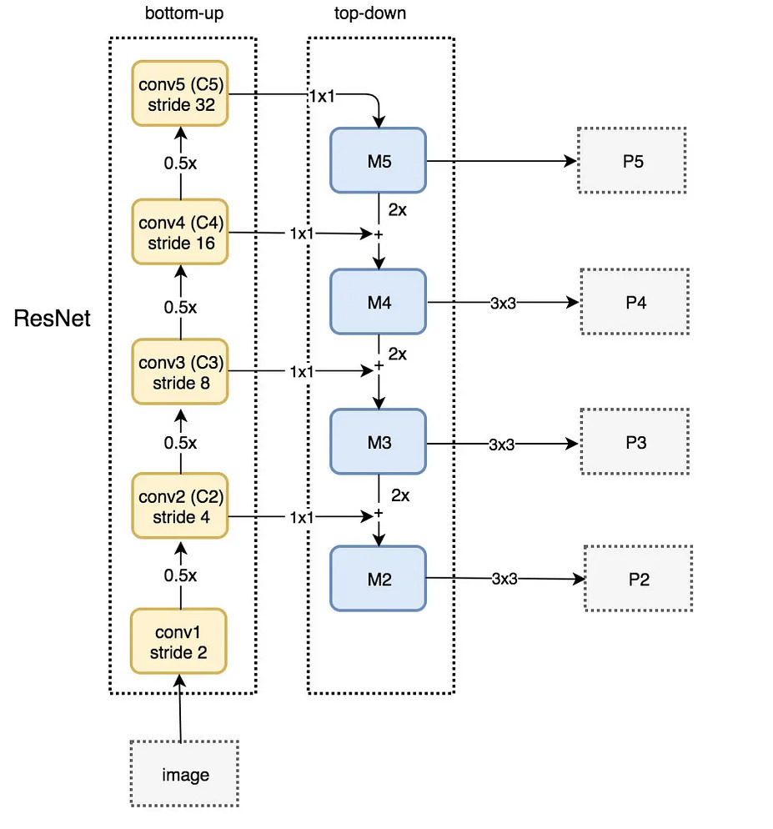
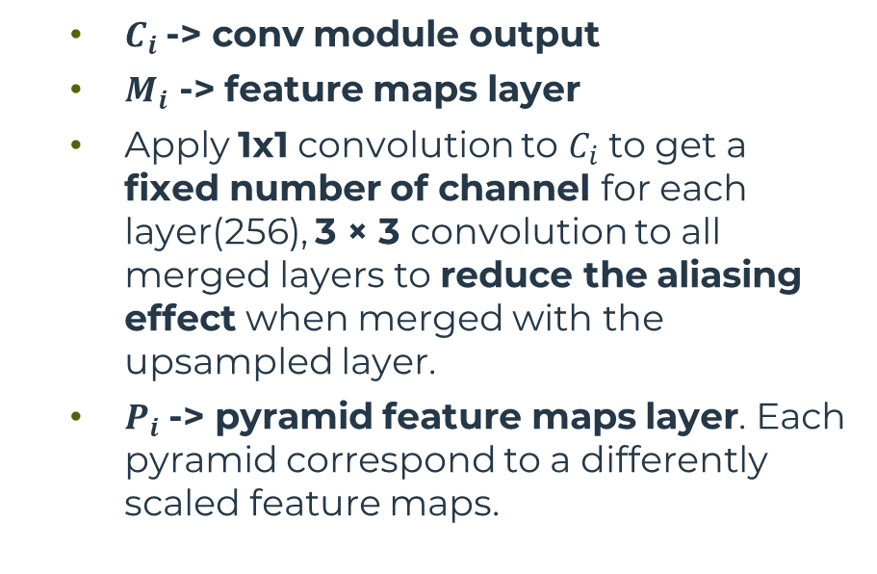
HW1 – Model Architecture
The architecture used is Faster R-CNN ResNet 50 fpn(Feature Pyramid Network) module for multi-scale feature extraction.
Figure of the backbone architecture
Notes:
Understanding Feature Pyramid Networks for object detection (FPN) | by Jonathan Hui | Medium
FPN(feature pyramid networks). Getting free accuracy boost on almost… | by Sanchit Tanwar | Analytics Vidhya | Medium
Review: FPN — Feature Pyramid Network (Object Detection) | by Sik-Ho Tsang | Towards Data Science
Review: Faster R-CNN (Object Detection) | by Sik-Ho Tsang | Towards Data Science
Easiest RPN explaination, the core of Faster R-CNN. | by Kai | LSC PSD | Medium

Slide 4
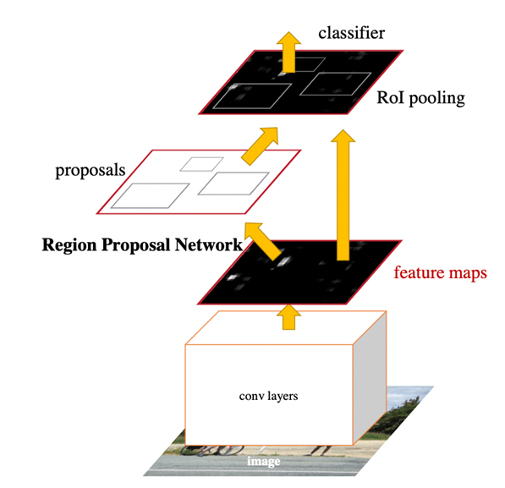
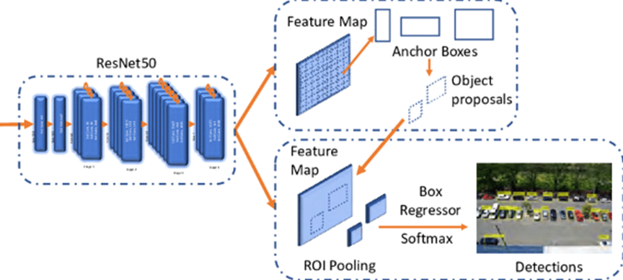
HW1 – Model Architecture
●Faster R-CNN Detection Network takes feature maps and RoIs generated by the RPN.
●For each RoI, it extract features using RoI pooling.
●RoI pooling adapts the features for each RoI using the convolutional feature map to the size of the RoI by dividing it into sub-window.
●Pooled features are then fed into a fully connected layer to predict class probabilities and bbox for each RoI.

Slide 5
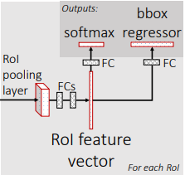
HW1 – Model Architecture
Based on the size of the ROI, we select the feature map layer in the most proper scale to extract the feature patches.
We apply the ROI pooling and feed the result to the Fast R-CNN head (Fast R-CNN and Faster R-CNN have the same head) to finish the prediction
Softmax with probabilities of belonging to each class
Bbox regressor, to refine the bboxes

Slide 6
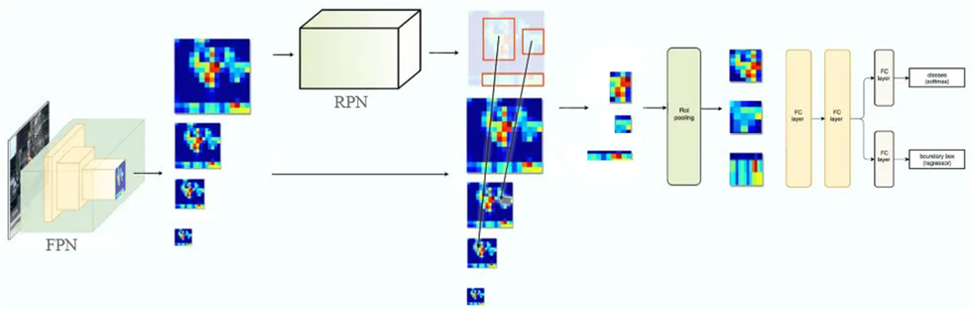
HW1 – Model Architecture
●FPN introduces top-down pathway which start with the feature map from the final convolutional layer of the ResNet50 backbone and up-samples it to generate higher resolutions feature maps.
●Each up-scaled feature map is fused with the corresponding feature map from the lateral connection module.
●RoI Align module is used to extract feature for each proposal region -> using bilinear interpolation.
●The Faster R-CNN Detection Network takes the features extracted by the RoI Align module and perform object detection.
●Loss is a combination of RPN loss and the Fast R-CNN loss.

Slide 7
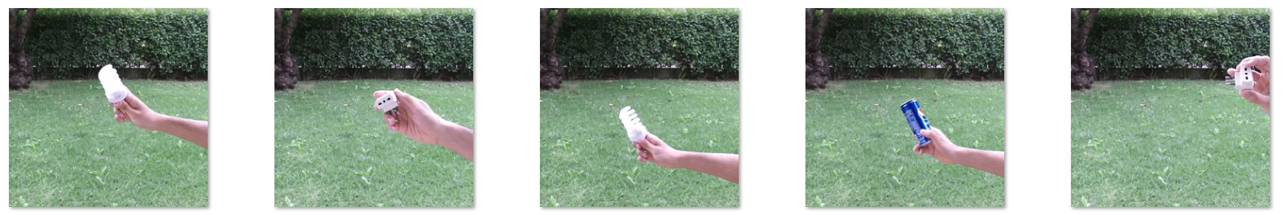
HW1 – Dataset overview
Training set:
1600 images
8 classes (triple sockets, phones, scissors, bulbs, cans of Pepsi, sunglasses, small balls, coffee cups)
200 images per class
Test set:
800 images
All the test set images are with grass and tress

Slide 8
HW1 – Training procedure
Data augmentation and transformations
Vertical flip, with p=0.5
ShiftScaleRotate (scale limit=0.25, rotate limit=45, p=0.7)
Moreover, the network:
Normalizes the input in the range ((0.7, 0.7, 0.7), std=(1, 1, 1) and the max pixel value=225.

Slide 9
HW1 – Hyperparameters
Optimizer
SGD
Learning rate
0.001
Momentum
0.9
Weight decay
0.0001
Batch size
8
# Epochs
8

Slide 10
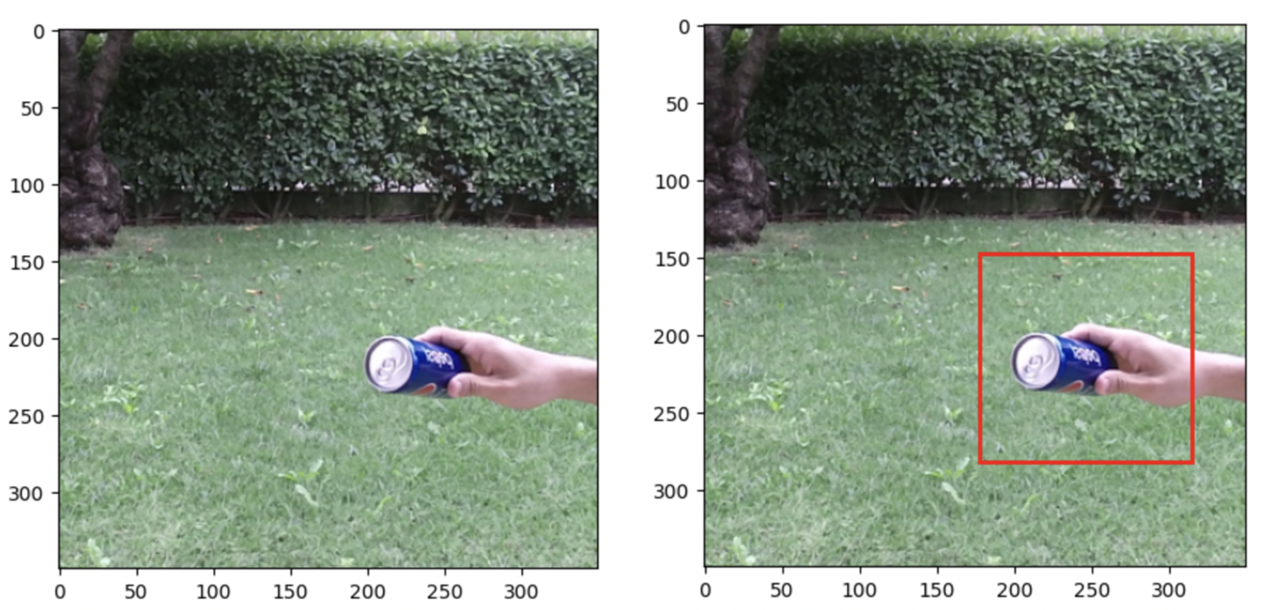
HW1 – Results
Original image
Bboximage

Slide 11
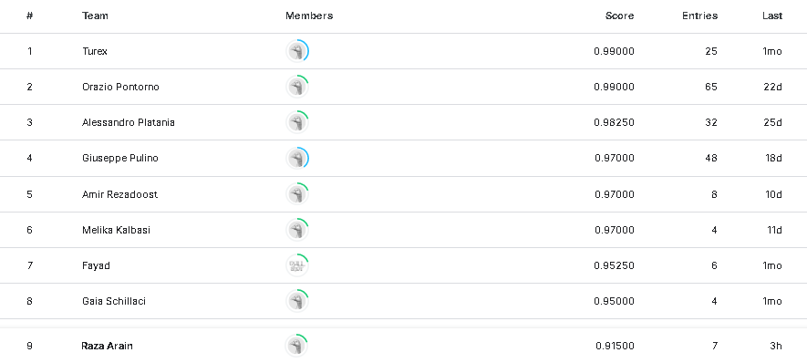
HW1 – Results
Kaggle challenge results

Slide 12
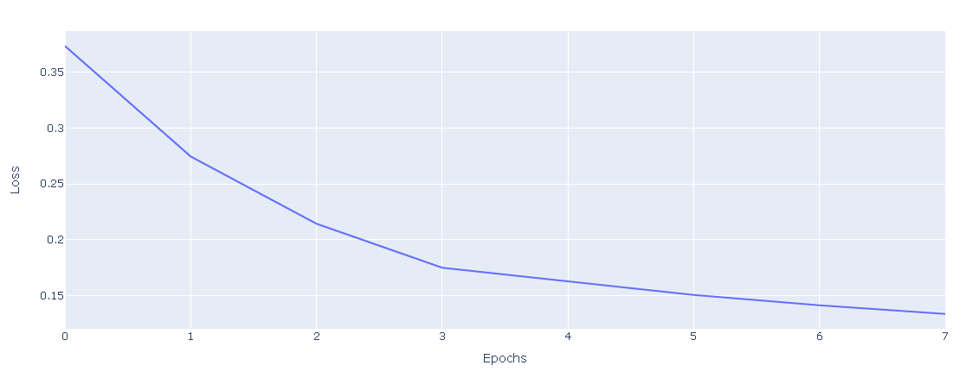
HW1 – Results
Faster R-CNN with Resnet50 FPN

Slide 13
HW1 – Previous results
➢First approach: First of all i try with Custom CNN but my experience is no soo good and i got the average accuracy 11.5%.
➢Second Approach: Secondly i use ResNet101 and the average accuracy is 39.5%.
➢Third approach: And in the last i use FasteRCNN and i got the average accuracy is 91.5%.

Slide 14
Thank you..

